Slide 1
CHEMISTRY
Radiation is all around us

Slide 2
Name that
symbol !!!!

Slide 3
School

Slide 4
Power button

Slide 5
Family

Slide 6
Pedestrian lane

Slide 7
Poison

Slide 8
Radiation warning (trefoil)

Slide 9
Today we will talk about:
Radiation
Sources of background radiation
Radiation dose monitoring in different areas of our school and
Various applications of radiation in daily living

Slide 10
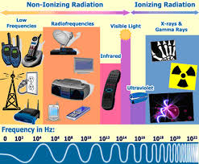
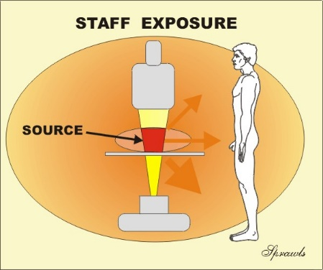
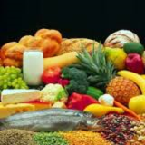
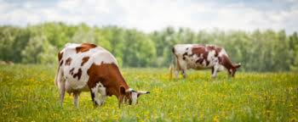
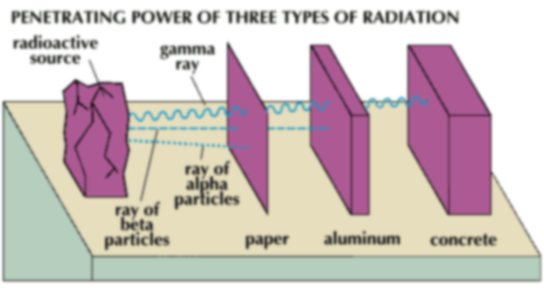
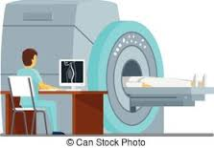
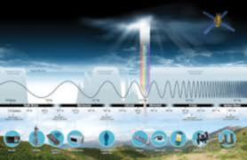
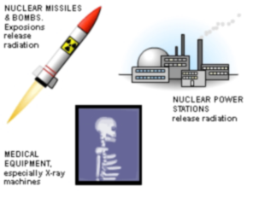
Radiation

Slide 11
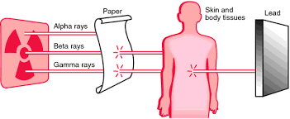
Invisible energy waves or particles
Is the emission of energy as electromagnetic waves or as moving subatomic particles.

Slide 12
Is radiation always present?

Slide 14
Radiation is always present in the environment.
Background Radiation
Natural radiation
Artificial radiation

Slide 15
Sources of Natural radiation

Slide 16
Cosmic Rays – radiation that reaches the earth from space

Slide 17
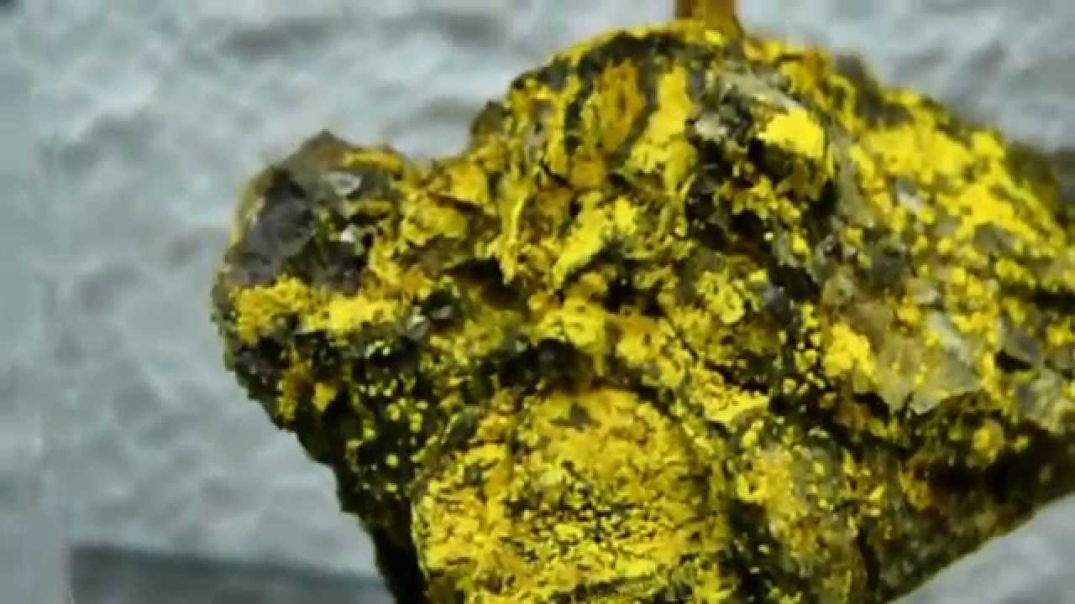
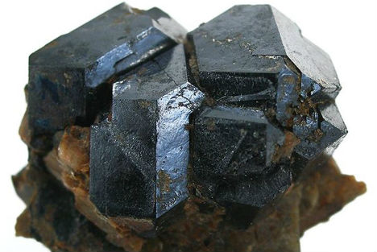

Slide 18
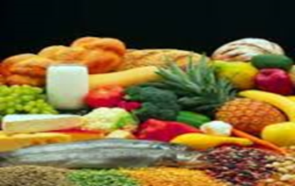
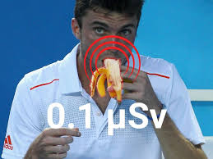
Living things —plants absorb radioactive materials from soil and these pass up to food chain.

Slide 19
Sources of Artificial radiation

Slide 20
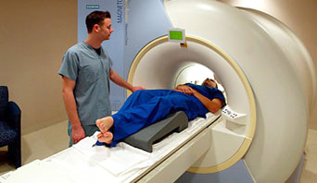

Slide 21
Radiation Hunt

Slide 22
“Radiation is all around us”
Objectives:
Observe and measure the radiation dose in a given station;
Compare the average radiation dose in different stations; and
Construct a bar graph showing the radiation dose reading of the different station.

Slide 23
Radiation Monitoring Survey Sheet
Station | First reading | Second reading | Third reading | Average reading
School ground
Near canteen
School Mini forest
Inside the classroom

Slide 24
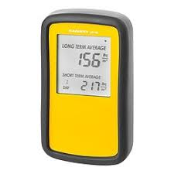
How to measure radiation dose?
Use radiation survey meter. (Handle with care)
Hold radiation meter at least 1 meter above the ground.
Switch on the radiation meter and wait for 1 minute before the actual reading.
Hakaru – kun or Radiation monitor

Slide 25
1 bar = 10 seconds
Record your monitored radiation dose
every 20 seconds for 1 minute
60 seconds

Slide 26
Unit used

Slide 27
Are you now ready for
Radiation Hunting?

Slide 28
Radiation hunt map
GROUP 1
Mini Forest
Near Canteen
Inside the
Classroom
School Ground

Slide 29
Radiation hunt map
GROUP 2
Near Canteen
School Ground
Mini Forest
Inside the Classroom

Slide 30
Radiation hunt map
GROUP 3
School Ground
Mini Forest
Inside the Classroom
Near Canteen

Slide 31
Radiation hunt map
GROUP 4
Inside the Classroom
School Ground
Near Canteen
Mini Forest

Slide 32
Observations and results will be done through suggested tasks:
Group 1 : News casting
Group 2 : Classroom scenario
Group 3 : Role playing
Group 4 : Panel discussion

Slide 33
Each group will be given 5 minutes to prepare the suggested task and another 5 minutes for the presentation.
Group Presentation
Group 2
Group 4
Group 1
Group 3

Slide 34
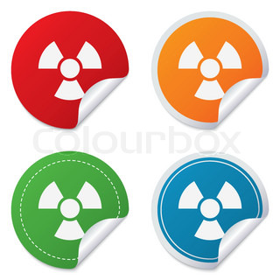
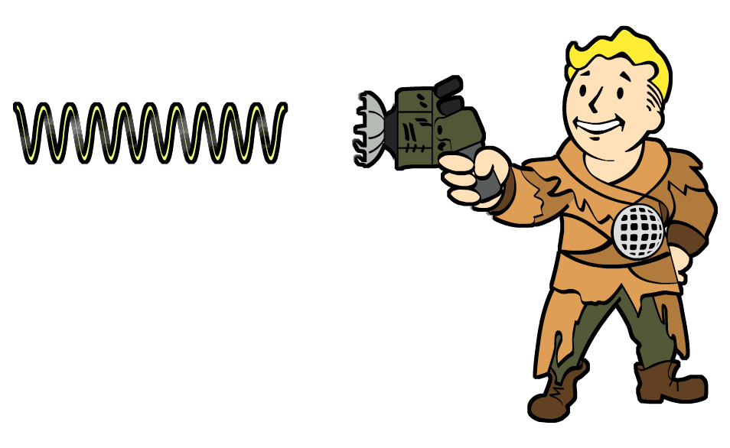
Let’s go hunting!

Slide 35
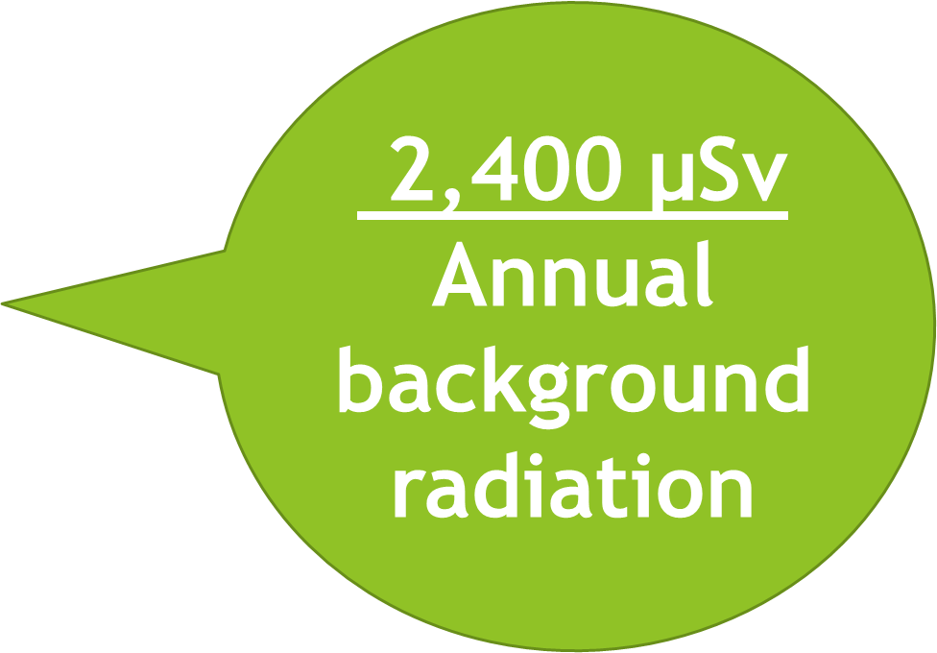
Compare the effective dose rate radiation on the result of your readings. Is it still within the normal value? Why?

Slide 36
Interpret the given data

Slide 38
The potential biological effects and damages caused by radiation depend on the conditions of the radiation exposure.
It is determined by:
Quality of radiation
Quantity of radiation
Received dose radiation
Exposure condition

Slide 39
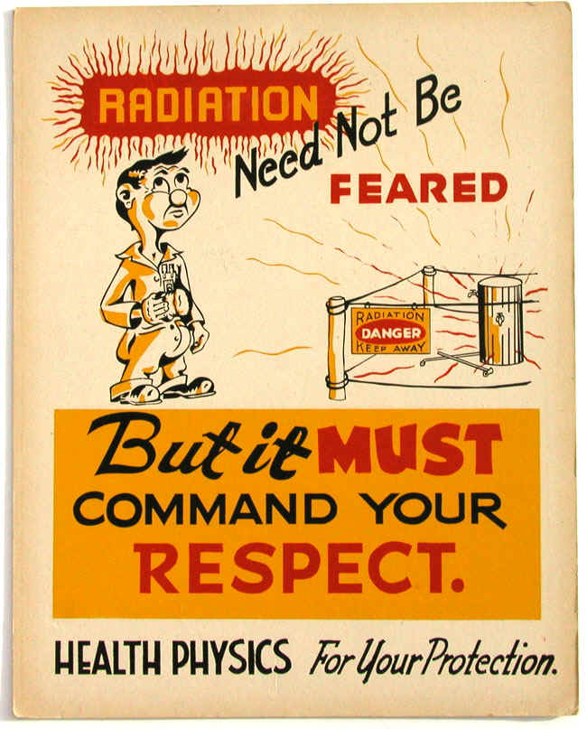
Reminder

Slide 40
Assignment
Read an article about “Practical uses of Radiation for various areas of our life”
Visit the PNRI website at : www.pnri.dost.gov.ph
Visit the PNRI Facebook page for more information about radiation

Slide 41
Note:
“We cannot see radiation through our naked eye, but radiation is available at all times and everywhere.”

Slide 42
Thank you
Prepared by:
Maylene S. Labonete

