Slide 1
CHEMISTRY
Radiation and Radioactivity
(Radioactive phenomenon)

Slide 2
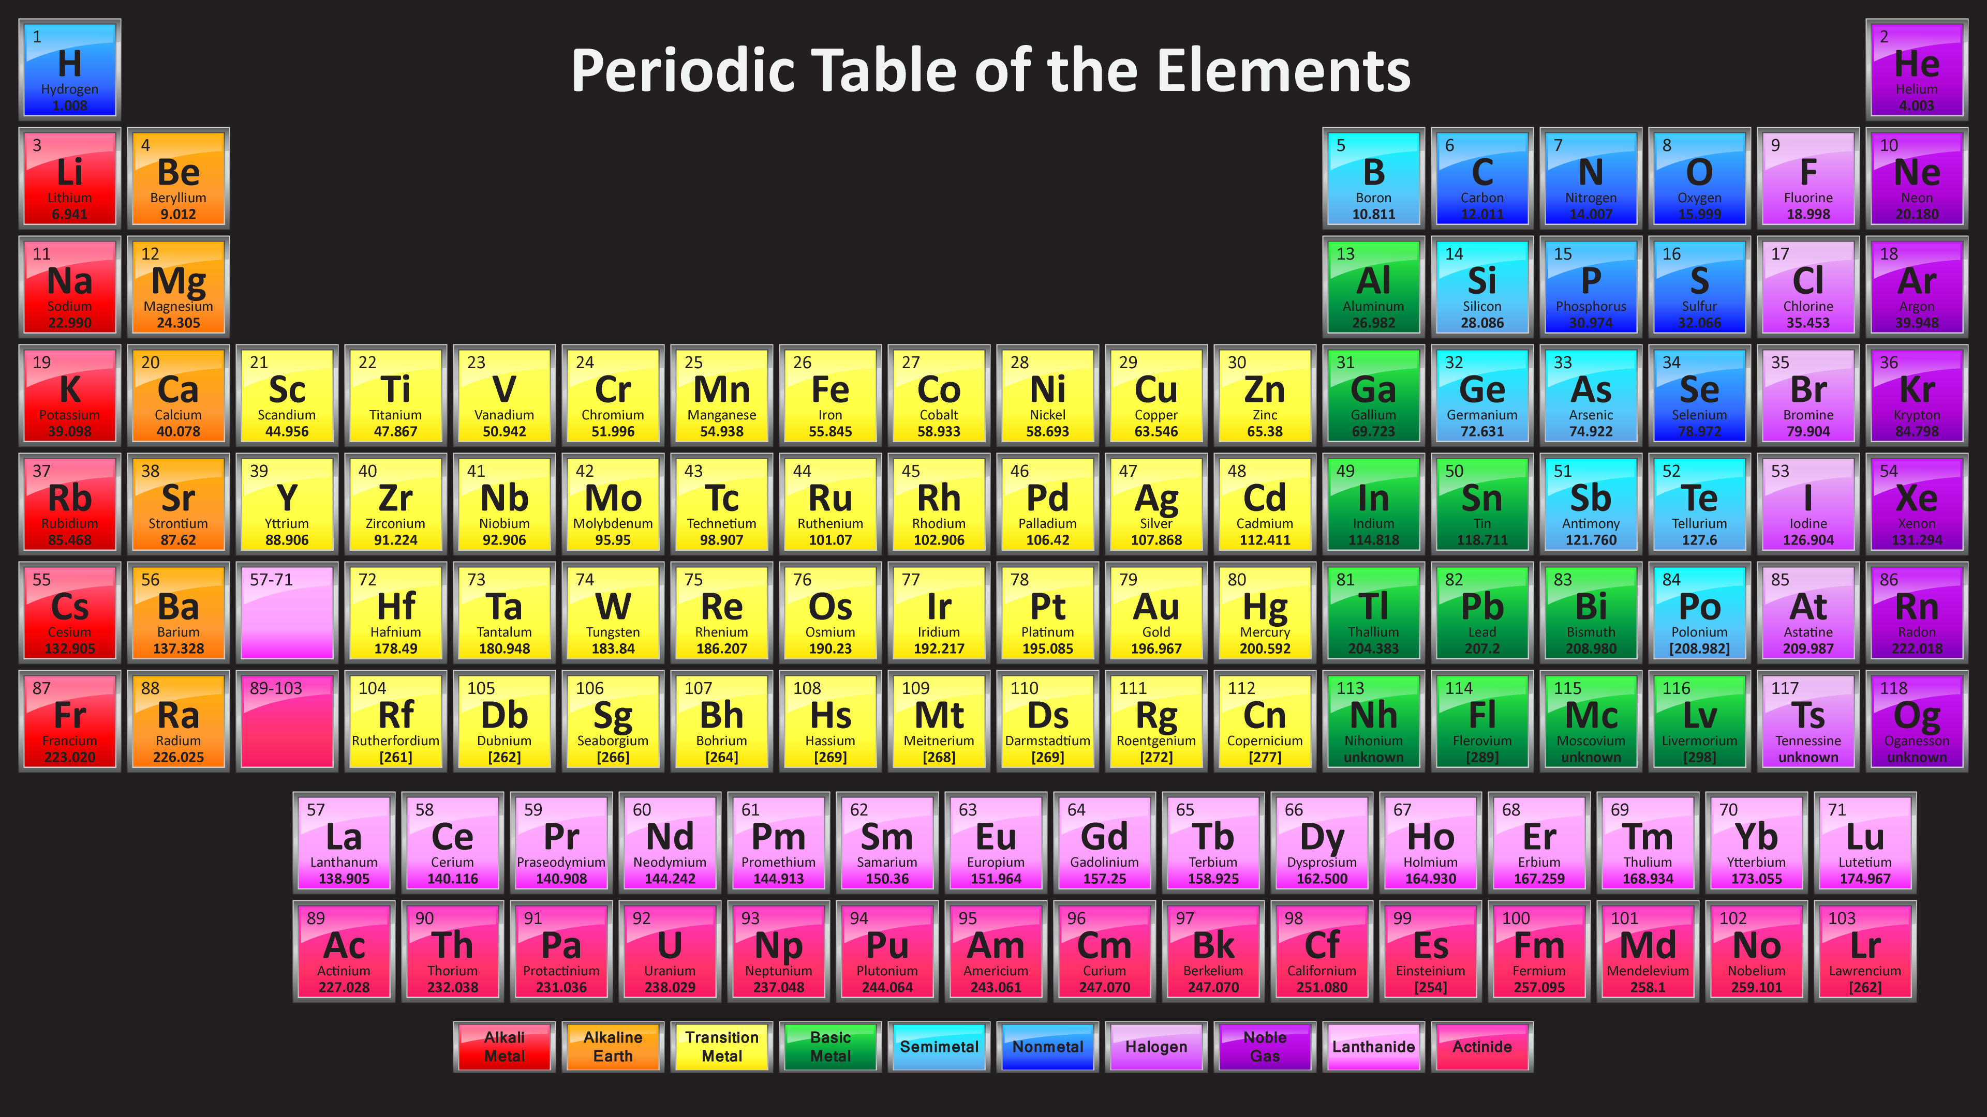
Photo Credits:https://sciencenotes.org/2016-2017-colorful-periodic-table-118-element-names/
Notes:
The teacher will ask the following questions.
How do we group the elements in the periodic table?
What are representative elements? early transition elements? late transition elements?
What are actinide series? What are lanthanide series?
What are those elements in the actinide series?
Why do we consider actinide series as radioactive elements?

Slide 3
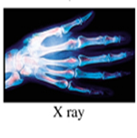
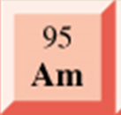
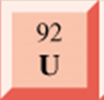
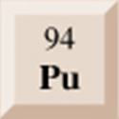
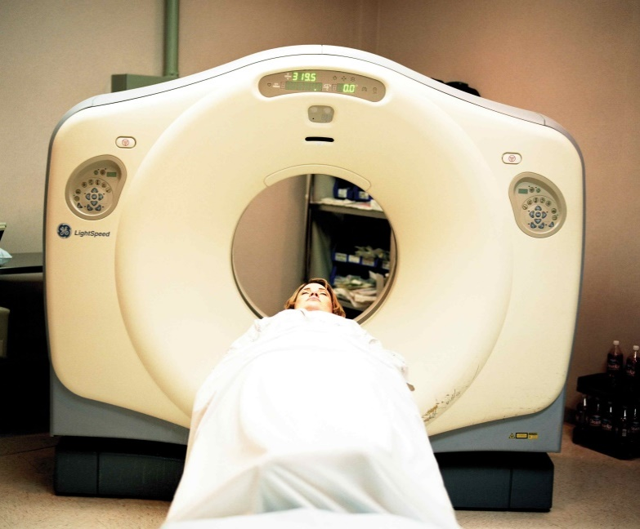
https://www.medicalnewstoday.com/articles/153201.php
http://medical dictionary.thefreedictionary.com/radiation+symbol
https://radiopaedia.org/cases/normal-hand
Notes:
Now, look at these pictures. (Teacher will ask the following questions)
1. What are these pictures?
2.What is common among the pictures?

Slide 4
RADIATION
Energy transmitted either as particles
or electromagnetic waves
RADIOACTIVITY
The characteristics of materials to emit ionizing radiation
Notes:
The teacher will say:
At the end of the lesson we will find out the history of radioactivity and the difference of the two words RADIATION and RADIOACTIVITY
Note: Only the word radiation and radioactivity will be flashed on the board and will hang on the definition
It will be flashed again after presentation of the history of radioactivity.

Slide 5
Non-ionizing radiation, on the other hand, has the capacity to change the position of atoms but not to alter their structure, composition, and properties.
Ionizing form of radiation has the power to create
charged ions by displacing electrons in atoms.
Notes:
This slide is optional in case there is an issue on forms of radiation comes out.

Slide 6
Alpha radiation travels only a few centimeters in air and can be stopped by a piece of paper.
Beta radiation travels tens of centimeters in air and can be stopped by a sheet of aluminum.
Gamma radiation travels many meters in air and when high dose rates are present, it can only be reduced to low dose rates and safety in a short distance by lead, or thick concrete.
Notes:
Optional slide if in case there is a need for clarifications of the alpha, beta and gamma radiation.

Slide 7
APPLICATIONS OF
RADIOACTIVITY
Notes:
This part of the lesson will be discussed after asking volunteers students to paste the pictures of the applications of radioactivity on the board .Some of the slides from 7-16 on the are just repetitions of the pictures that will be posted on the table in the elaboration part of the lesson. So some slides are optional and can be used if still there is need for more clarifications.

Slide 8
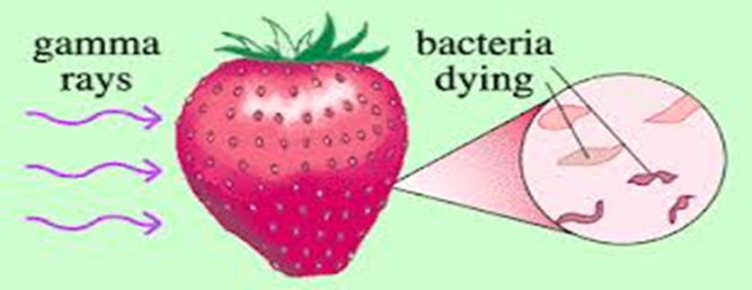
FOOD TECHNOLOGY
Food sterilization by gamma irradiation is the process of exposing food to ionizing radiation to destroy microorganisms, bacteria, viruses, or insects that might be present in the food. Irradiated food does not become radioactive.
https://www.emaze.com/@AQWWZOCF/food-irradiation
Notes:
Integration of radioactivity in food technology.

Slide 9
Type of food | Effects of Radiation
Meat, poultry | Destroys pathogenic fish organisms, such as Salmonella, Campylobacter and Trichinae
Perishable foods | Delays spoilage; retards mold growth; reduces number of microorganisms
Grain, fruit | Controls insects in vegetables, infestation of dehydrated fruits, spices and seasonings and reduces rehydration time
Onions, carrots, potatoes, garlic, ginger | Inhibits sprouting
Bananas, mangos, papayas, guavas, other non-citrus fruits | Delays ripening of avocados, natural juices
Notes:
If there is need of more discussion of the Effects of radiation in food this table could be discussed.

Slide 10
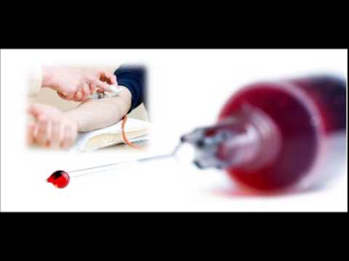
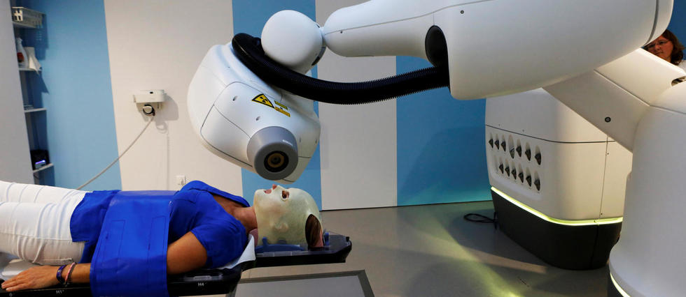
Radioisotopes in Medicine
Chromium-51 - used to
label red blood cells and
quantify gastro-intestinal
protein loss.
Cobalt-60 - used for
cancer treatment
https://www.slideshare.net/sagarlingot/gamma-rays-sterilization
Notes:
This slide will be used if there will be problem with the part of elaborating the application of radioactivity in Medicine.

Slide 11
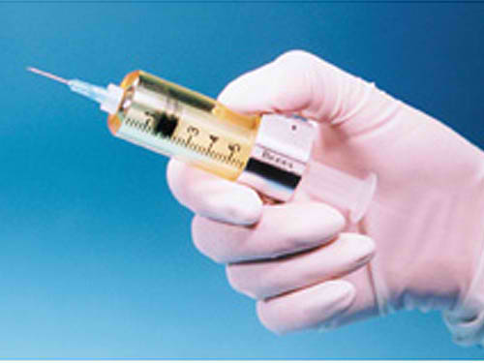
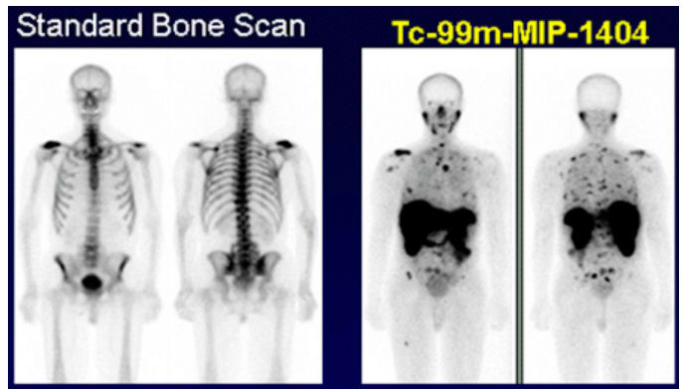
Radioisotopes in Medicine
Samarium-153 is very effective in
relieving the pain of secondary cancers lodged in the bone. Also very effective for prostate and breast cancer.
.
Technetium-99 - used to image the skeleton and heart muscle in particular, but also for brain, thyroid and lungs
http://medicalphysicsweb.org/cws/article/research/53772
Notes:
This slide will be used if there will be problem with the part of elaborating the application of radioactivity in Medicine.

Slide 12
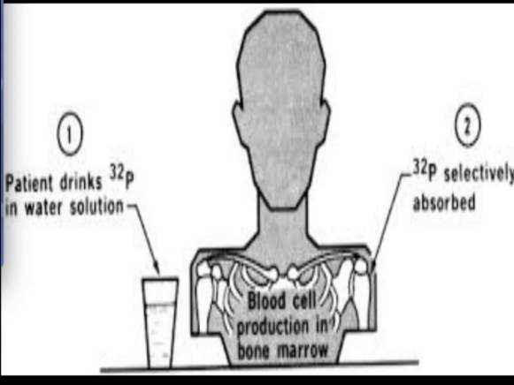
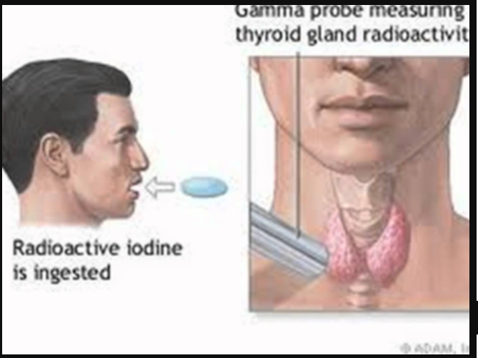
Radioisotopes in Medicine
Phosphorus-32 - used in
the treatment of polycythemia
vera (excess red blood cells);
Also used for cancer detection.
Iodine- 131 – used for the measurement of thyroid activity and treatment of thyroid cancer.
https://uichildrens.org/adam/1/radioactive-iodine-uptake
Notes:
This slide will be used if there will be problem with the part of elaborating the application of radioactivity in Medicine.

Slide 13
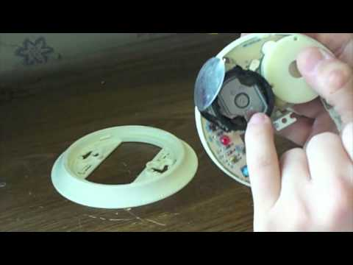
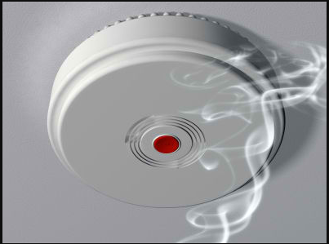
As Smoke Detector
Americium -241 Used in smoke detectors.
http://www.chemistrylearner.com/americium-241.html
Notes:
This slide has the picture of smoke detector emitting gas – This can be used if in case the students are not familiar with smoke detector.

Slide 14
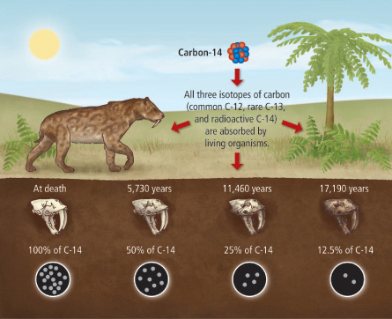
Radiocarbon Dating
also referred to as carbon dating or carbon-14 dating is a method for determining the age of an object containing organic
https://socratic.org/questions/what-do-scientists-learn-about-fossils-by-using-carbon-14
Notes:
This slide could be used in integrating radioactivity in Archeology.

Slide 15
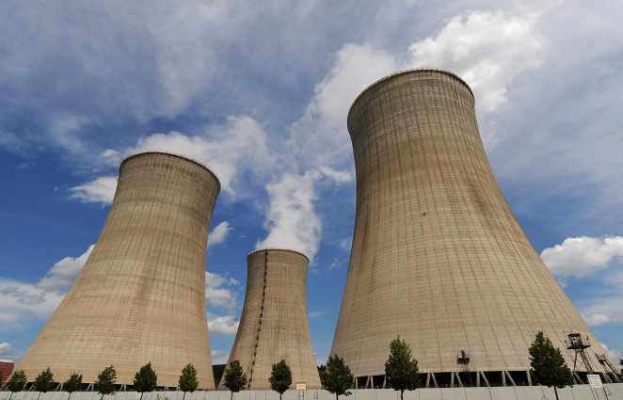
Radioisotopes as Energy Source
Nuclear power plants do not burn any fuel. Instead, they use uranium fuel, particularly U-235 consisting of solid ceramic pellets, to produce electricity through process called fission.
https://wattsupwiththat.com/2017/02/20/risk-and-nuclear-power-plants/
Notes:
This slide will be used for additional explanation or emphasis of nuclear energy from power plant.

Slide 16
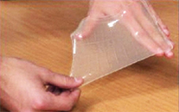
Radioactivity in Material Science
Water-soluble polymers, also known as hydrogels, are commercialized for wound dressing, specifically for burn wounds and diabetic ulcers
Heat-shrink tubing is used to insulate wires, providing abrasion resistance and environmental protection for stranded and solid wire conductors, connections, joints and terminals in electrical work.
http://www.cablecraft.co.uk/protect/heatshrink-cable-repair-solutions.html
https://www.researchgate.net/publication/256463162_Starch-based_biomaterials_for_wound-dressing_applications
Notes:
This shows the applications of radioactivity in materials science . This could enhance the discussion from the students activity on posting the pictures on the board.

Slide 17
FACT
OR BLUFF
Notes:
This will be used in the evaluation part of the lesson. The students should have fan sign of “BLUFF” and “FACT” slides 18-22 will be showed in class one by one and students will answer by raising their fan sign if the statement flashed on the board is correct or not. FACT for correct concept and BLUFF for wrong concept.

Slide 18
1. Henri Becquerel used Philosopher’s stone in discovering radioactivity.
Notes:
The answer is BLUFF

Slide 19
2. Marie Curie coined the word
radioactivity.
Notes:
The answer is FACT

Slide 20
3.Carbon dating is one way of knowing the age of woods and artifacts.
Notes:
The answer is FACT

Slide 21
4. Alpha, Beta and Neutron are types of radiation.
Notes:
The answer is BLUFF

Slide 22
5. Food irradiation is a process that exposes food to radiation. Irradiation is used to kill bacteria that cause food poisoning or to slow down the ripening of fruits and vegetables.
Notes:
The answer is FACT

Slide 23
“Nothing in life is to be feared, it is only to be understood. Now is the time to understand more, so that we may fear less.”
- Marie Curie
Notes:
Famous quote by Marie Curie. Ask volunteer student to read it.
What is implied from the quote?

Slide 24
Are you in favor of the operation of a Nuclear Power?
Notes:
Ask the student to relate the quote by Marie Curie with the above question.

Slide 25
ASSIGNMENT
Write an essay regarding your opinion about the advantages and disadvantages of using Nuclear Power.
Notes:
This is an assignment to encourage students to read and research on the advantages and disadvantages of the Nuclear power.

