Slide 1
EARTH AND SPACE
VOLCANIC ERUPTION : RADIATION FROM IGNEOUS ROCK

Slide 2
Recall
When do we say that a volcano is active?
When do we say that it is inactive?
Notes:
Recall of the definitions of these terms before you proceed.

Slide 3
Classify the following volcanoes as active or inactive.
Notes:
Clap three times if the volcano is active but do not clap if the volcano is inactive.
Say the name of the volcanoes one at a time and observe the student responses.

Slide 4
Answers:
Canipo - inactive
Banahaw - active
Bulusan - active
Didicas - active
Matutum - active

Slide 5
Objectives of the lesson:
Identify the material emissions during volcanic eruption.
Measure and calculate the radiation dose in igneous rock samples.
Infer that all rocks emit radiation.
Suggest ways on how to minimize the level of contamination.
Notes:
Ask a learner to read each objective to the class.

Slide 6
Mayon Volcano
Notes:
Tell the learners that they will watch a video. Prior to this, ask them to give reminders on what they are supposed to do while watching a video.

Slide 7
Questions:
From the video, what are the emissions of Mayon Volcano?
What do you call the rocks from volcanoes?
Do you think these rocks give off radiation?
Notes:
These questions will be asked after watching the video.

Slide 8
Brain mapping
Think of a word or words that will define this phrase:
radiation dosimetry

Slide 9
Experiment Time!
RADIOLOGICAL SURVEY

Slide 10
Objective
To measure and compare the radiation dose of given volcanic rock samples.

Slide 11
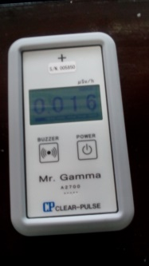
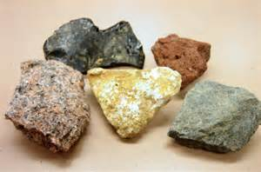
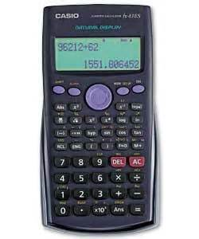
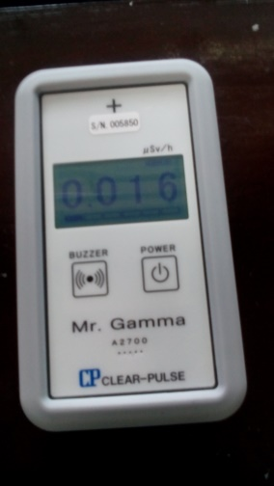
Materials and equipment
Hakaru-kun
Igneous rock
samples
Pen
Calculator

Slide 12
Operating the hakaru-kun
Press the POWER button to turn on the device.
When the “beep” sound is heard, continue to press the button until the number is displayed on the screen.
Wait for 60 seconds to stabilize the device.
Measured dose rate is displayed after one minute.

Slide 13
Procedure
Measure the radiation readings outside the room. Do this for five trials and calculate the average. This is the background radiation.

Slide 14
Procedure
Proceed to the designated area and measure the radiation dose of the provided rock sample using the Hakaru-kun. Do this for five times and calculate the average. Record your data in a table.

Slide 15
Procedure
Subtract the average background reading from the dose rate reading in each trial.
Record the readings in the data sheet. The average of the five trials is the average dose rate on the specified rock sample.

Slide 16
Procedure
Draw the rock sample used.

Slide 17
Data table
Rock Sample | Average Dose Rate
 | Trial
 | 1 | 2 | 3 | 4 | 5 | Ave
andesite
granite
peridotite
scoria

Slide 18
Sample data
Rock Sample | Average Dose Rate (μSv/h)
 | Trial
 | 1 | 2 | 3 | 4 | 5 | Ave
andesite | 0.2 | 0.2 | 0.3 | 0.2 | 0.3 | 0.24
To get the average dose rate for each rock, use the formula:
(Dose rate reading with the rock in each trial – average background reading)/ no. of trials

Slide 19
Sample data
Rock Sample | Average Dose Rate | Daily Dose Rate (2 hrs) | Weekly Dose Rate (5 days) | Monthly Dose Rate (4 wks) | Annual Dose Rate (10 mos)
andesite | 0.24 | 0.48 | 2.4 | 9.6 | 96

Slide 20
Experiment time
Checking the background area
Measuring the radiation dose of rock samples
Computation of radiation based on exposure
Preparation of worksheets and data for presentation

Slide 21
Group Output Presentation

Slide 22
Guide Questions:
How will you describe the radiation dose from rock samples?
Notes:
Each rock sample has different radiation dose.

Slide 23
Guide Questions:
Based on the computed radiation dose, is it necessary to minimize the exposure to igneous rocks?
Notes:
It is not necessary to minimize exposure to igneous rocks since the radiation that they give off is very minimal.

Slide 24
Radiation dosimetry

Slide 25
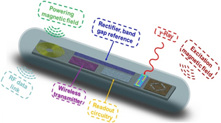
Radiation dosimetry
Defined as the quantitative description of the effect of radiation on living tissue.

Slide 26
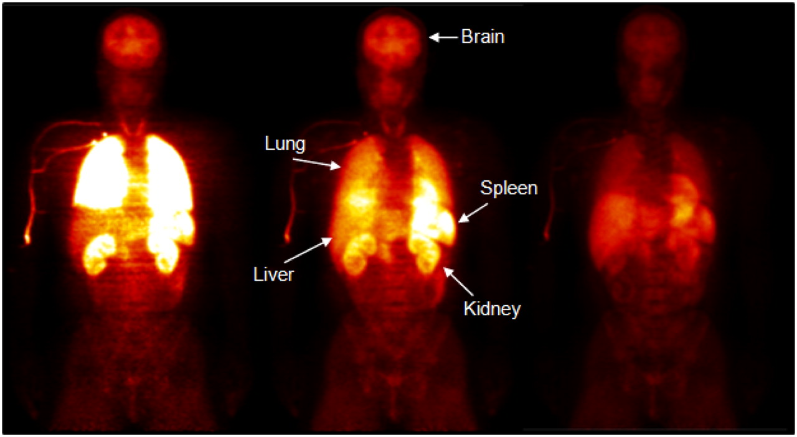
Dosimetric quantities
Absorbed dose
Equivalent dose
Effective dose

Slide 27
Absorbed dose
is a physical quantity to measure the radiation energy absorbed by unit mass of substances.
the concentration of energy deposited in tissue as a result of an exposure to ionizing radiation.
Gray – unit for absorbed dose (1 Gy is equivalent to 1 J/kg).

Slide 28
Equivalent dose
is the measure of the biological effects of a particular type of radiation on organ or tissue.
“A measure of the dose to a tissue or organ designed to reflect the amount harm caused.” (IAEA)
The unit of equivalent dose is 1 J/kg, termed the Sievert (Sv).
The rem, equal to 0.01 Sv, is sometimes used as a unit of equivalent dose.

Slide 29
Effective dose
is the measure of the effect of a particular type of radiation on organs or tissues.
is used to assess the potential for long-term effects that might occur in the future.
is a calculated value, that takes three factors into account:
the absorbed dose to all organs of the body.
the relative harm level of the radiation; and
the sensitivities of each organ to radiation.

Slide 30
Effective dose
the quantity of effective dose helps us take into account sensitivity.
different body parts have different sensitivities to radiation.
relates to the overall long-term risk to a person and useful for comparing risks.
the unit is the same as that of equivalent dose –Sievert (Sv).

Slide 31
What is the recommended exposure limit to occupational worker and member of the public?

Slide 32
The NCRP and ICRP Recommendations
 | NCRP-116 | ICRP 60
Occupational Exposure
Effective dose Annual Cumulative | 50 mSv 10 mSv x age (y) | 50 mSv 100 mSv for over 5y
Equivalent Dose Annual | 150 mSv lens of eye 500 mSv skin, hands, feet | 150 mSv lens of eye 500 mSv skin, hands, feet
Exposure of public
Effective Dose Annual | 1 mSv if continuous 5 mSv if infrequent | 1 mSv; higher if needed provided that the average over 5 y does not exceed 1 mSv
Equivalent Dose Annual | 15 mSv lens of eye 50 mSv skin, hands, feet | 15 mSv lens of eye 50 mSv skin, hands, feet

Slide 33
Ionising Radiations Regulations 1999 (IRR 99)
establishes a good regulatory framework for reducing workers exposure to radiation.
The recommended dose limit is 20 mSv per year.

Slide 34
Problem Solving
Suppose that the reading from a survey meter in an area near a source is 0.10 μSv/hr and a person works in the area for an average of 4 hours per day, 5 days a week, 48 weeks in a year, will the radiation dose limit to the worker be exceeded?

Slide 35
Answer
The answer is 480 μSv
0.10 μSv/hr x 4 hr x 5 days x 48 weeks / year
= 480 μSv
Hence, the radiation dose is below the limit which is 50 mSv.

Slide 36
Document –based learning
If you were to build a house, would you like its walls and/or flooring be made of rocks and other related materials? Explain.
Notes:
Ask the learners tor ead this question aloud but let them write down their answer in their notebook. This will be self-checked after reading an article.

Slide 37
Document-based learning

Slide 38
Question:
“Based from the journal, would you like to use igneous rocks and other related resources as building materials for your home? Why or why not?”
Notes:
Pose this question after the learners have read the article.

Slide 39
Possible answer:
According to the research, the radiation given off by rocks is below the limit of dose rate. Hence, they are safe to use as building materials for home. We should not sacrifice durability with misconception on radiation.

Slide 40
Question:
If in case, your radiation dose exceeds the limit, what will you do?
With your groupmates, prepare a 2-3 minute group presentation on the positive and negative effects of radiation to humans and how to minimize the negative effects through:
Pantomime
Song/Jingle
TV News reporting
Poem
Rap

Slide 41
Rubrics for group presentation
 | Criteria |  |  |  | Points
 | 1 | 2 | 3 | 4
Organization | Audience cannot understand presentation because there is no sequence of information. | Audience has difficulty following presentation because presenters jump around. | Audience can follow the sequence of the presentation. | The presentation is interesting and organized.
Content knowledge | Presenters do not have grasp of information; they cannot answer questions about the topic. | Presenters are uncomfortable about information and finds difficulty in answering questions. | Presenter is at ease with content but finds it difficult to elaborate. | Presenters demonstrate full knowledge with explanation and elaboration.
Visuals | Presenters used visuals. | Presenters rarely used visuals to support text. | Visuals used are related to text and presentation. | Presenters used visuals to reinforce text and presentation.
Mechanics | There are four or more grammatical errors during the presentation. | There are three grammatical errors during the presentation. | There are not more than two grammatical errors during the presentation. | Presentation has no grammatical errors.
Delivery | Presenter’s voice was not loud and clear. | Audience has difficulty hearing the presentation. | Presenter’s voice is clear. | Presenter’s voice is clear and words are pronounced precisely.
Notes:
Flash this on the screen while the learners prepare their presentation.

Slide 42
Generalization

Slide 43
Concept Matrix
Radiation in
igneous rocks
To summarize the important concepts on radiation in igneous rock, let’s construct a concept matrix.
With a partner, construct a concept matrix.
In the concept matrix, write down four main concepts or ideas on radiation in igneous rocks that you have learned from this lesson.

Slide 44
Evaluation: Individual whiteboards
Get your individual whiteboards.
Record your answers on individual whiteboards. I will move around the class and observe your responses.
Raise your whiteboards when I ask you to do so.

Slide 45
Evaluation:
Which of the following is a volcanic emission?
A. breccia
B. granite
C. limestone
D. marble

Slide 46
Evaluation:
Calculate and answer the following:
Suppose that the reading from a survey meter in an area near a source is 0.20 μSv/hr and a person works in the area for an average of 5 hours per day, 5 days a week, 55 weeks in a year, will the radiation dose limit to the worker be exceeded?

Slide 47
Evaluation:
Classify this statement as TRUE or FALSE
Hakaru-kun can measure all types of radiation.

Slide 48
Evaluation:
Classify this statement as TRUE or FALSE.
All rocks emit radiation.

Slide 49
Evaluation:
Classify this statement as TRUE or FALSE
All radiation from rocks is harmful, to limit exposure to radiation, one must not have prolong exposure to rocks.

Slide 50
Answers:
B
275 μSv. No, the radiation dose is below the limit for human exposure to radiation.
False
True
False

Slide 51
Agreement
Research on the chemical composition of the igneous rocks used in the activity that make them a natural radioactive source.
Reference: Earth Science by Tillery and Tarbuck or any reference material.

Slide 52
Thank you!!!!

