Slide 1
EARTH AND SPACE
Radon Emission as Earthquake Precursor

Slide 2
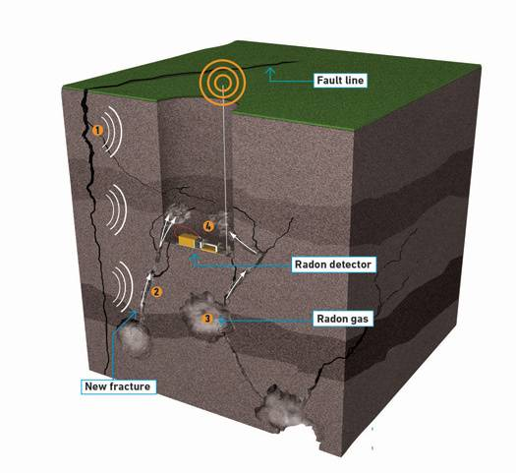
Can you guess how radon emissions are used as a clue to seismic vibrations?
http://www.popsci.com/technology/article/2010-11/underground-radon-detectors-could-forecast-earthquakes-days-they-happen

Slide 3
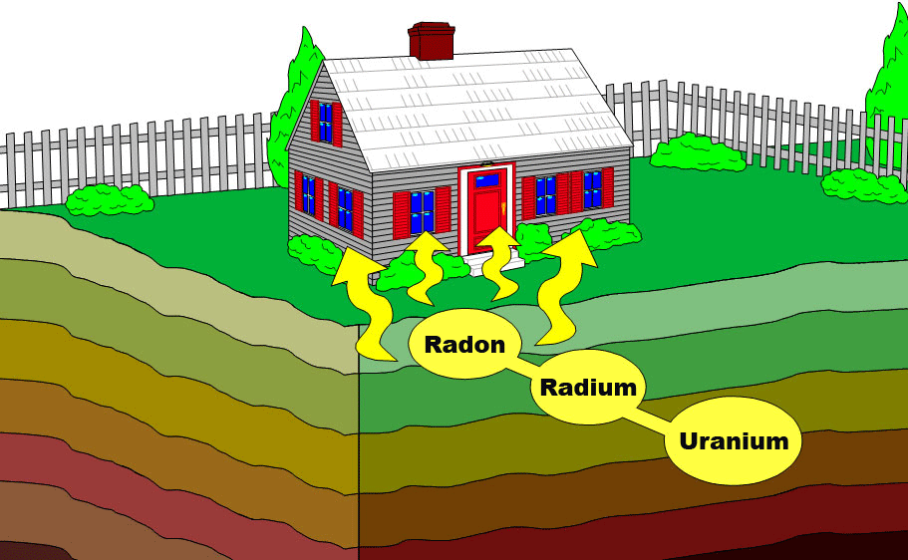
Radon
Is an odorless, tasteless, and colorless gas that occurs naturally. It is usually found in igneous rocks, soil, and also in water.
Is produced in soil by radioactive decay of radium, produced in turn by uranium.

Slide 4
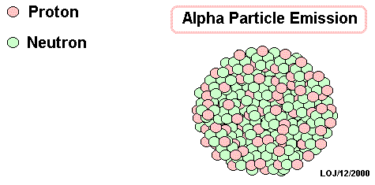
Radioactive decay is a natural, spontaneous process in which an atom of one element breaks down to form another element by losing atomic particles.

Slide 5
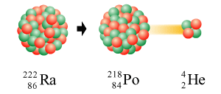
Radon
Is also a radioactive gas because it also decays losing an alpha particle forming the element Polonium. It has a half life of 3.8 days.
Rn
R]

Slide 6
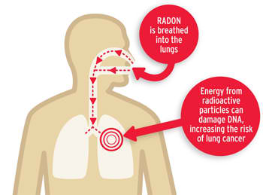
Radon
is a carcinogenic substance. Exposure to radon over a long period of time can increase the risk of developing lung cancer.
https://www.cancer.org/cancer/cancer-causes/radiation-exposure/radon.html

Slide 7
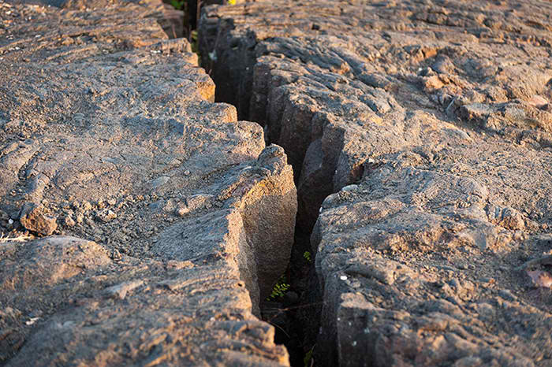
Radon
Has been used as indicator of fault and possible tool for earthquake prediction.

Slide 8
HOW THE RADON DETECTOR MIGHT WORK

Slide 9
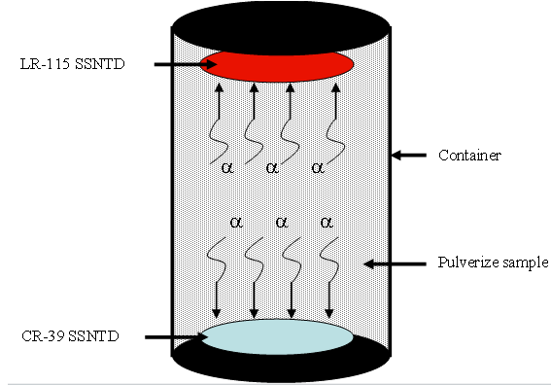
Alpha Track Detectors
are buried into the ground for a certain period of time and then retrieved to test measure the emitted alpha particles
Notes:
Radon flows into the detector through filtered opening. As the radon inside the detector decays, the emitted alpha particles hit the film forming tracks on the film. After the film processing, the tracks are counted to determine radon concentration. The results are analyzed statistically to determine the radon anomaly.

Slide 10
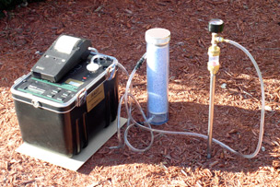
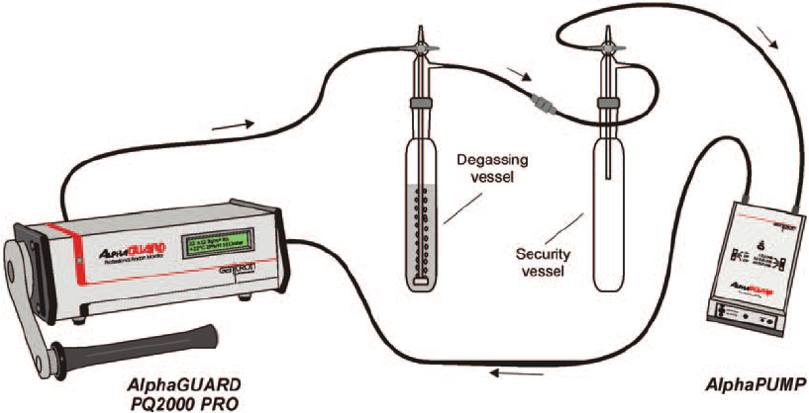
Portable, battery powered devices
are used for different measurements of radon.

Slide 11
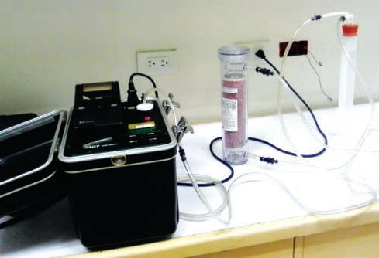
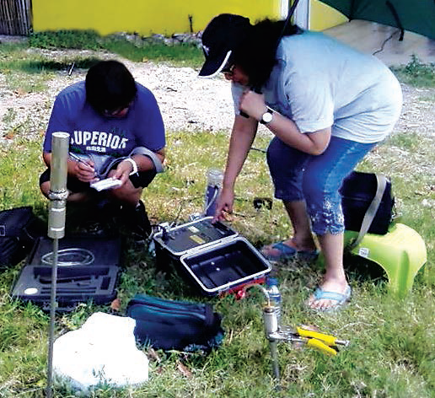
Radon measurement in soil gas and water using the portable electronic-based Durridge radon detector
Researchers from Philippine Nuclear Research Institute performing radon measurement along the Valley Fault System

Slide 12
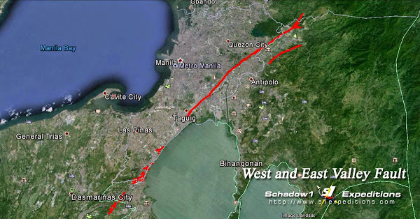
PNRI researchers continue to study the potential of radon as a supplementary predictive tool for short-term monitoring of large earthquakes.

Slide 13
Other Nuclear Techniques Used in Studying Fault and Earthquake Prediction

Slide 14
Radiocarbon dating
is a method of determining the age of rock by measuring the Carbon-14 decay in the organic materials found on it.
determine the frequency and date of previous earthquake occurrence or movement along the fault

Slide 15
Optically Stimulated Luminescence | OSL
measures the time elapsed since the last exposure of minerals like quartz to solar radiation. This
provides an estimation of the time of burial of those minerals during sediment accumulation.

Slide 16
References:
Department of Science and Technology-Philippine Nuclear Research Institute. (2016). Philippine Nuclear Research Institute 2015 Annual Report..Quezon City, Philippines.
Riggio A. and Santulin M.; 2015 Earthquake Forecasting: A review of Radon as Seismic Precursor, Istituto Nazionale di Oceanografia e di Geofisica Sperimentale (OGS),Trieste, Italy.
http://www.physicslovers.com/radioactivity/radioactive-decay
https://www.ck12.org/book/CK-12-Physical-Science-Concepts-For-Middle-School/section/3.64/
https://www.cancer.org/cancer/cancer-causes/radiation-exposure/radon.html
http://www.epa.ie/radon/householders/
http://pubs.sciepub.com/env/1/2/4/figure/4
http://durridge.com/products_soil_gas_probe.shtml

