Slide 1


Regional
Demonstration Teaching:
Validation of Lesson Exemplar Integrating Nuclear Science
July 26, 2017
Mrs. Ma. Regaele A. Olarte
Muntinlupa National
High School
Division of Muntinlupa City

Slide 2
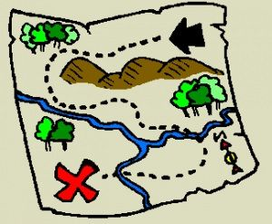
A WALK-THROUGH
FROM THE PAST
(Making Connections)
You have previously learned…
how the geographical location of the Philippines is related to landmasses and bodies of water (Grade 7);
how earthquakes, tsunamis, and typhoons develop (Grade 8);
what happens when volcanoes erupt (Grade 9).
In our previous lesson (Grade 10), you have learned how to locate earthquake epicenters in order to determine which fault lines are active.

Slide 3

describe the relationship among the locations of volcanoes, earthquake epicenters, and mountain ranges;
trace the distribution of active volcanoes, earthquake epicenters, and
major mountain belts;
recognize the importance of ensuring disaster preparedness during volcanic eruptions and earthquakes through disaster information dissemination.

Slide 4
SCORE SHEET
Skill
(25% Collaborative Activity Performance): _____
Meta-Fun (5%) = ______
Act-It-Out (5%) = ______
Let’s Mark the Boundaries (15%) = ______
Knowledge and Understanding
(25% Written Laboratory Report): ______
Transfer of Understanding
(50% Product/Performance Task): ______
YOUR SCORE: _______

Slide 5


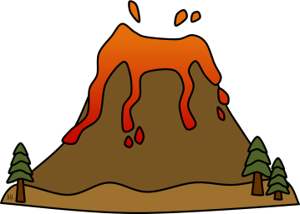
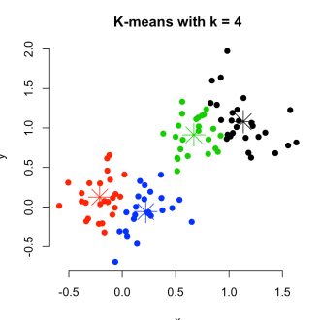
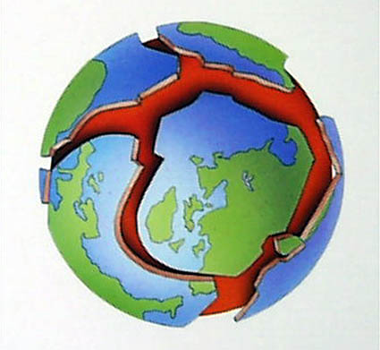

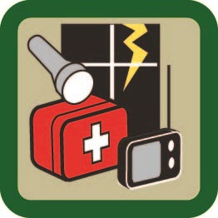
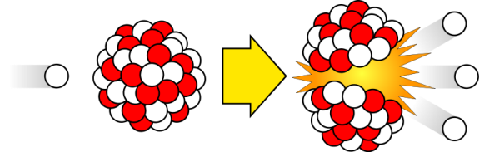

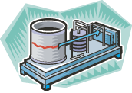
LESSON OVERVIEW
Mountain Ranges/Belts
Volcanoes
Earthquake Epicenters
found or situated at the same locations
concentrated along PLATE BOUNDARIES
considered in DISASTER PREPAREDNESS
movement occurs due to the radiogenic heat of the Earth
Information dissemination
not randomly distributed on the Earth
early detection
planning
radioactive decay of elements

Slide 6
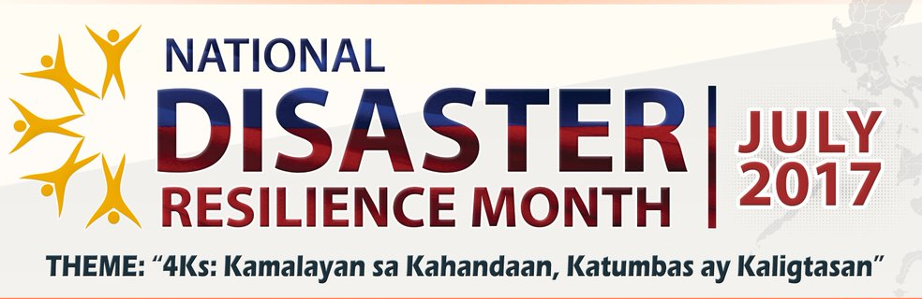
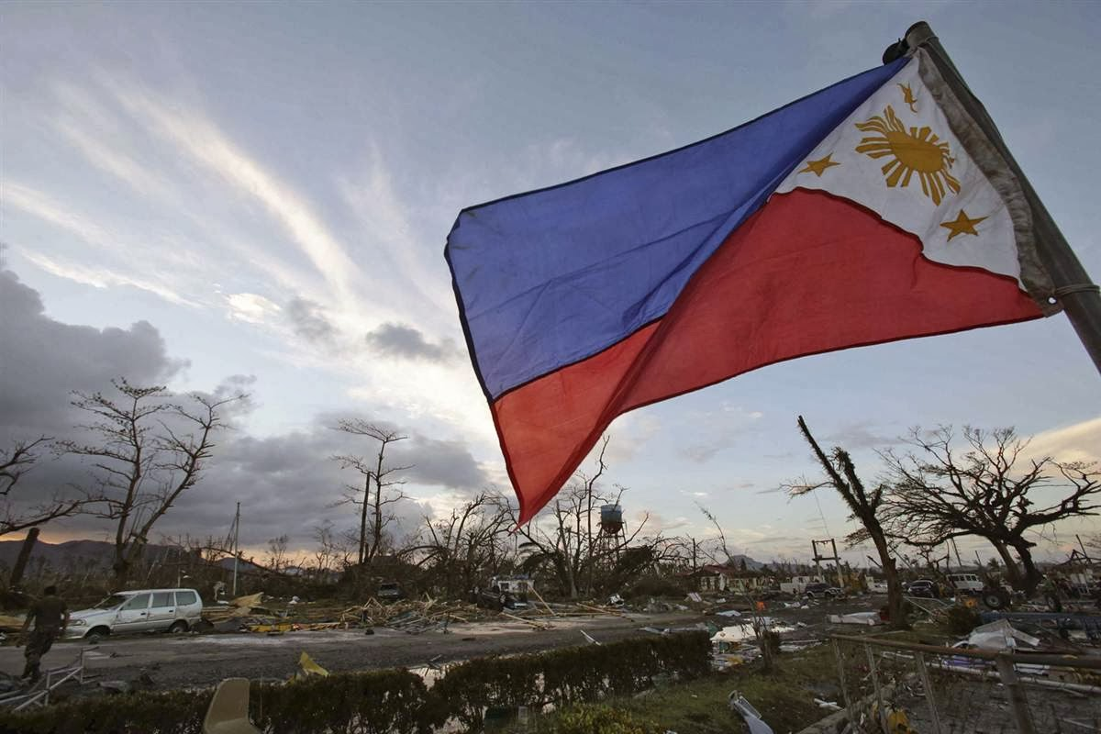

Slide 7


Task #1: META-FUN!
Let’s ELICIT…
Within your group, brainstorm ideas about the natural hazards that are commonly occurring in the Asia-Pacific Region. Choose a group member who will act as moderator to draw out all the ideas of the members about these natural disasters. Each member’s answer must be written on the blank card that will then be collected by the moderator. Stick and organize all the responses on the blackboard to sort out which answer falls under a particular category.

Slide 8
How do volcanoes work?
Local areas of heating within the Earth's crust or near the top of the Earth's mantle cause regions where the rock partly melts.
The source of heat is radioactive decay of elements in the mantle, including Potassium (K) and some Uranium (U) as well as other elements with radioactive isotopes.
Lava is expelled onto the Earth's surface primarily by the work of gases that exsolve from the melt as it rises toward the surface.

Slide 9
How do earthquakes work?
Energy for earthquakes comes from nuclear energy in Earth's mantle. Radioactive decay produces heat that causes convection in the mantle.
This movement is transferred to Earth's crust where movement stores up energy in rocks, like a spring being stretched. When the rock breaks, the stored energy is released suddenly.
This energy is then carried outwards from the break by seismic waves, a form of energy radiation.

Slide 10

Task #2: ACT-IT-OUT!
Let’s ENGAGE…
Study the pictures that will be shown on the next slide. Think of how you will react to each given event in the picture and demonstrate it by acting out your response. Your whole group will enact altogether your initial response upon seeing the given pictures. Compare your reaction with your other classmates’.

Slide 11
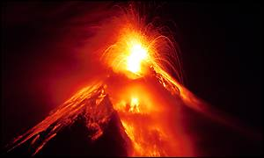
http://news.bbc.co.uk/2/hi/asia-pacific/659745.stm

Slide 12
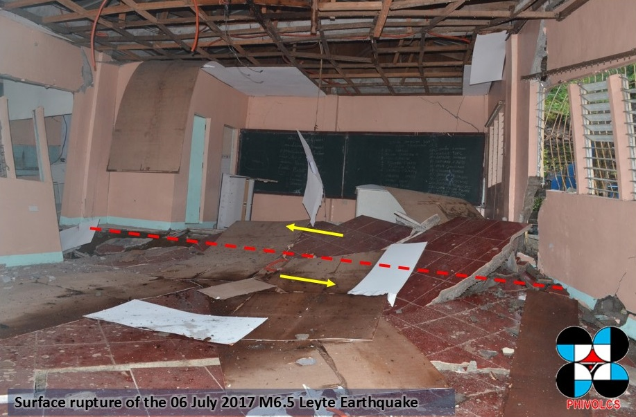
Leyte Earthquake 2017/ phivolcs.dost.gov.ph

Slide 13
Task #3 (Main Activity):
Let’s Mark the Boundaries
Let’s EXPLORE…
(DepEd Grade 10 Learners’ Material, Unit 1: Earth and Space, Module 1) Materials: Map of Earthquake Distribution Map of Active Volcanoes of the World Map of Mountain ranges of the World 2 pcs transparent plastic sheet marking pens (two different colors)

Slide 14
Let’s EXPLORE…
Instructions (Group Activity):
Let’s Mark the Boundaries
1. Using the given map of earthquake distribution, trace the locations of the earthquake epicenters on a plastic sheet with a marking pen.
2. Using the map of active volcanoes, trace the locations of volcanoes on another plastic sheet with a differently colored marking pen.
3. Place the earthquake plastic sheet on top of the volcano plastic sheet.
4. Place the two plastic sheets on top of the map of mountain ranges.
5. Observe and analyze the locations of volcanoes, earthquake epicenters, and mountain ranges based on the marked sheets.

Slide 15
GUIDE QUESTIONS:
How are earthquakes distributed on the map?
How are volcanoes distributed on the map?
How will you compare the location of majority of earthquake epicenters with the location of volcanoes around the world?
How will you describe the relationship of mountain ranges with the distribution of earthquake epicenters and volcanoes?
What did you observe as you traced the distribution of active volcanoes, earthquake epicenters, and major mountain belts?
Knowing that the Philippines is part of the Ring of Fire, what preparations need to be done in order to be equipped when disaster strikes?

Slide 16
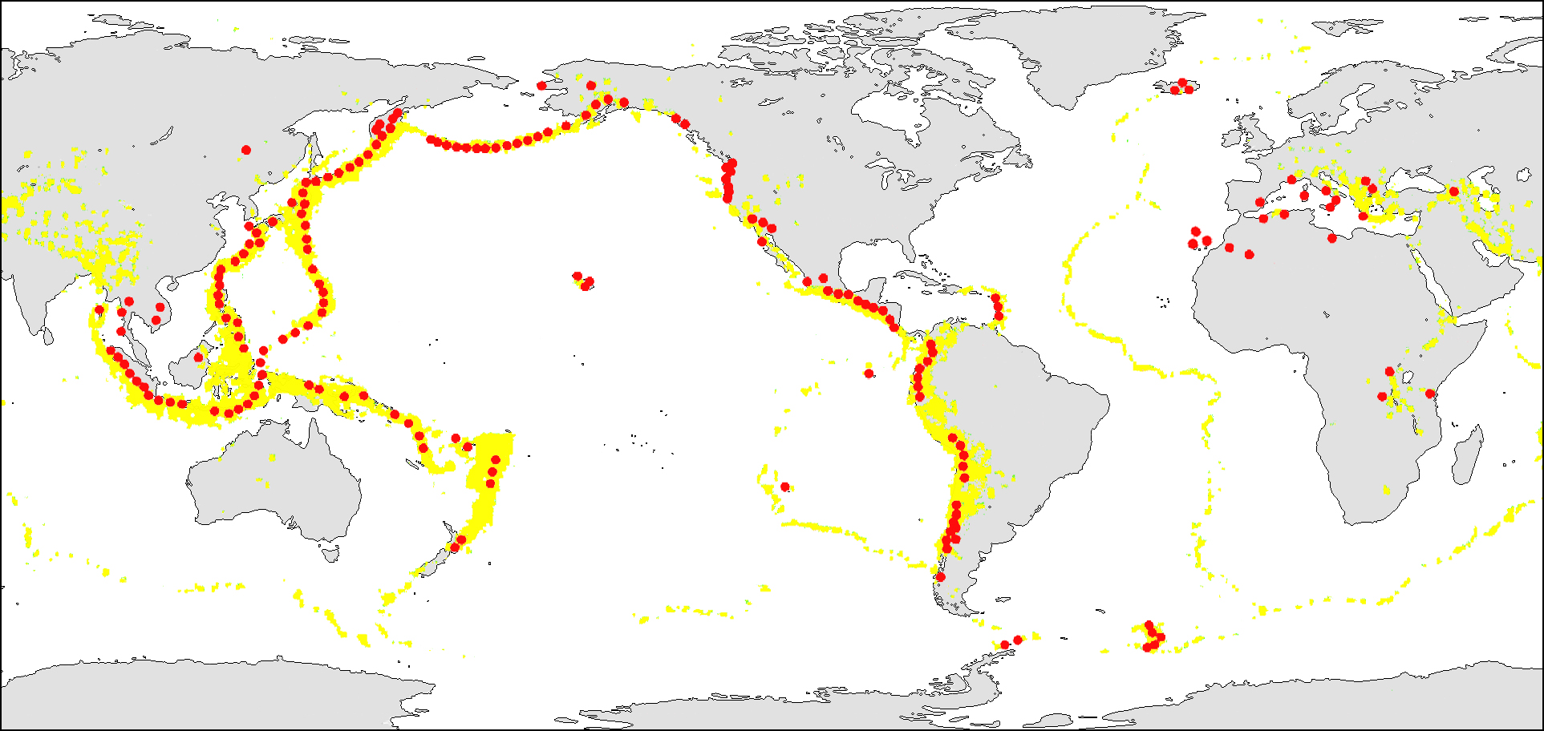
Map of Active Volcanoes of the World

Slide 17
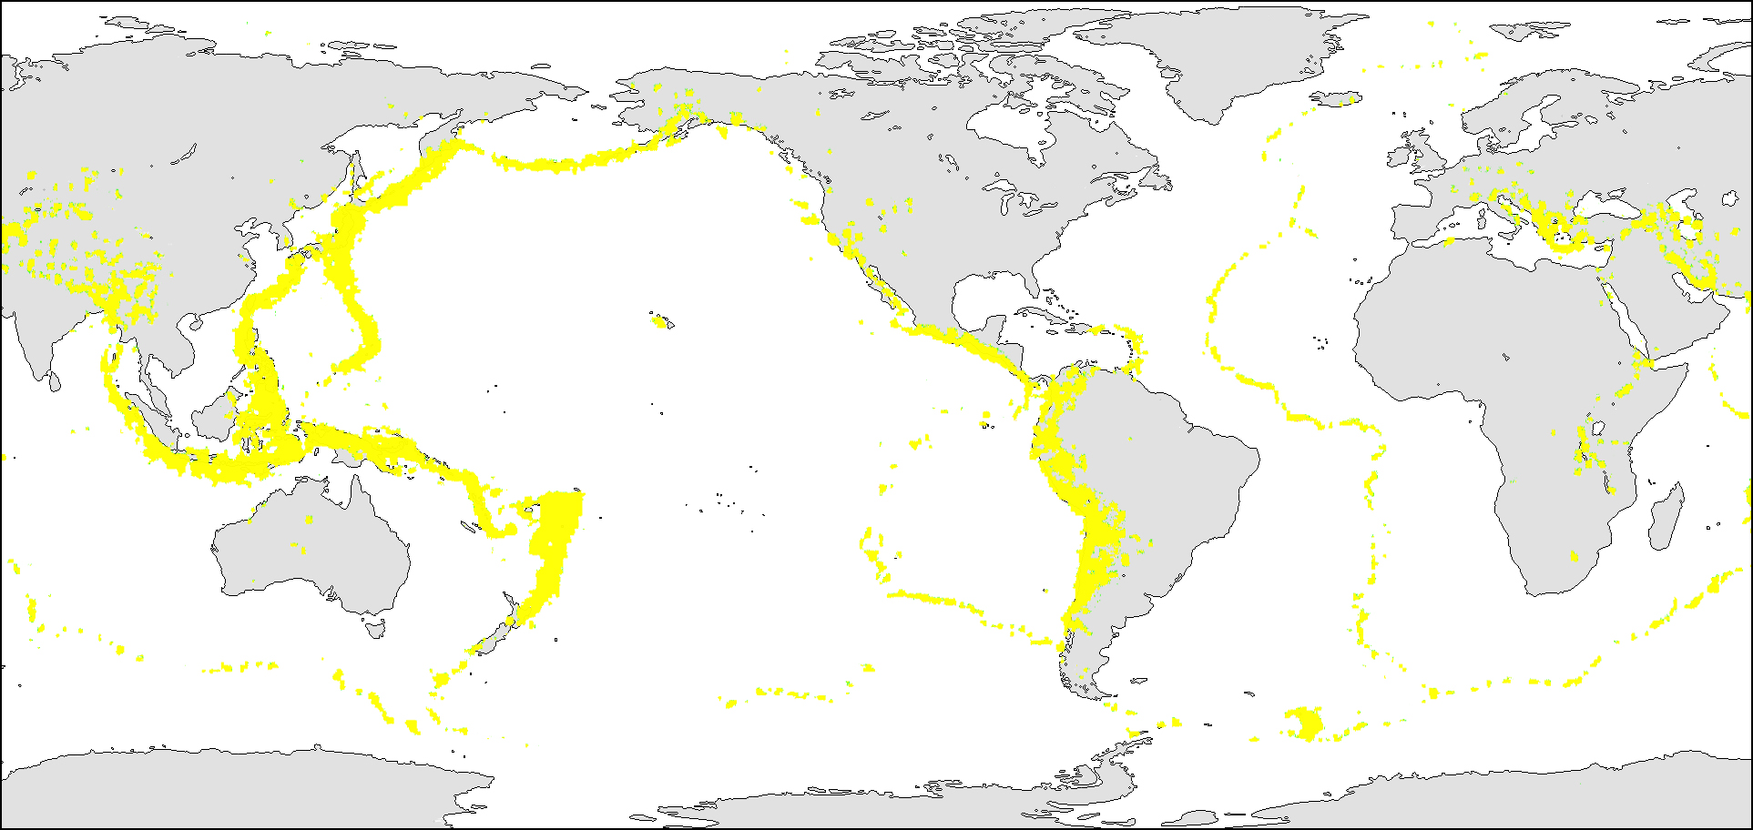
Map of Earthquake Distribution

Slide 18
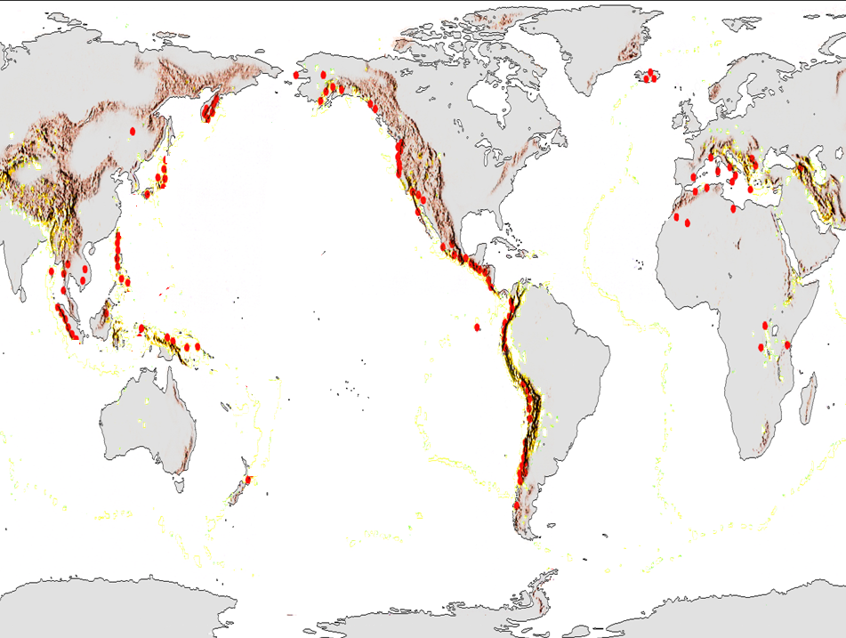
Map of Mountain Ranges of the World

Slide 19
How will you describe the relationship among the locations of volcanoes, earthquake epicenters, and mountain ranges?

Slide 20
What occurs at plate boundaries?

Slide 21
What drives the
movement of the plates?

Slide 22
Additional Information/Trivia:
Approximately 90% of the most powerful volcanic eruptions and about 81% of the world’s largest earthquakes have occurred along the Ring of Fire.
(Conners, 2016).

Slide 23
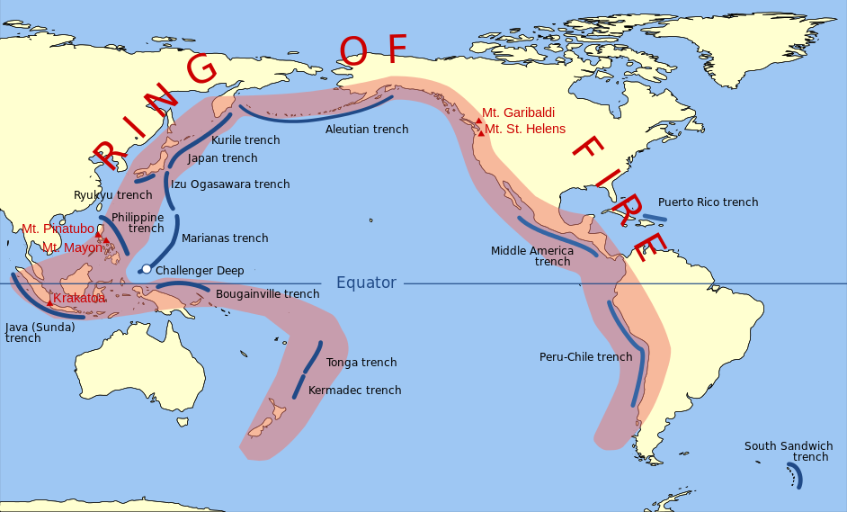

Slide 24
Additional Information/Trivia:
The existence of many radioactive elements in significant amounts such as Rn, RaA, RaB, RaC, Tn, ThA and ThB is confirmed in volcanic gases, which are comparable to that of the gases from the strongly radioactive mineral springs.
Iwasaki, I., Katsura, T., Shimojima, H. et al. Bull Volcanol (1956) 18: 103. https://doi.org/10.1007/BF02596614

Slide 25
Considering the distribution of active volcanoes in the Ring of Fire and the radioactivity of the volcanic emissions, what preparations could be made to minimize the risks and reduce the damage should a disaster (volcanic eruption or earthquake) occurs?

Slide 26
Laser beams can be used to detect plate movement. In order to detect very small surface movements, electronic distance measurements are made.
A seismometer is used to pick up the vibrations in the Earth's crust. Records of seismic waves allow seismologists to map the interior of the Earth, and locate and measure the size of these different sources.
Radioactive Radon gas escapes from cracks in the Earth's crust. Levels of radon gas can be used as precursor for the movement of fault lines and occurrence of earthquakes.

Slide 27
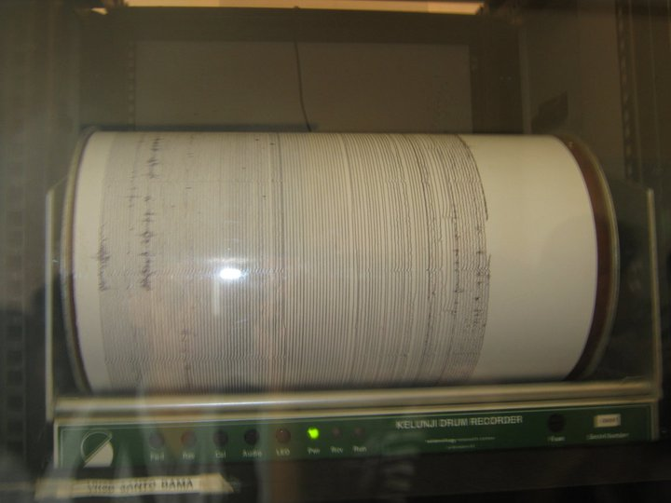

A seismometer used by PHIVOLCS
Source: Philippine Institute of Volcanology and Seismology

Slide 28
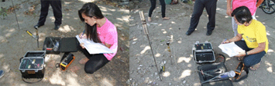

Radon Monitoring
Source: Philippine Nuclear Research Institute
PNRI Research Title:
Radon Monitoring of the Valley Fault System and Philippine Fault and Its Implication as an Earthquake Precursor

Slide 29
In preparing for a possible volcanic eruption, a detailed plan is needed, and it includes: creating an exclusion zone around the volcano; being ready and able to evacuate residents; having an emergency supply of basic provisions, such as food; funds need to be available to deal with the emergency and a good communication system needs to be in place.
Bbc.co.uk. (2017). BBC - GCSE Bitesize: Predicting and preparing for volcanoes.

Slide 30
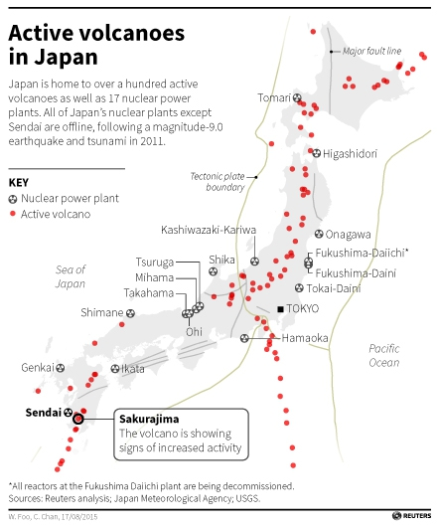

Slide 31
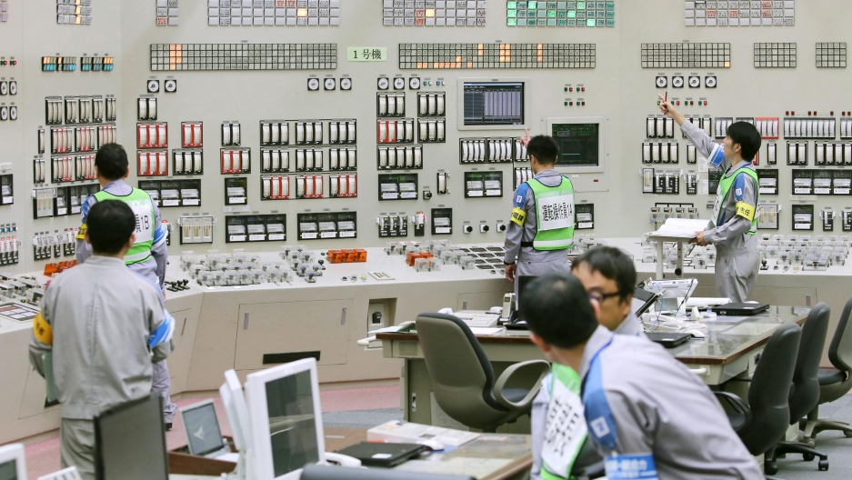
In 2011, all of Japan's nuclear reactors were shut down. To reopen, plants must pass new safety requirement.
Plants must have an upgrade plan, an engineering work plan and receive pre-service inspections.
These upgrade plans must include disaster preparedness.
Sendai Nuclear Power Station in Japan
(Reuters, 2015)

Slide 32
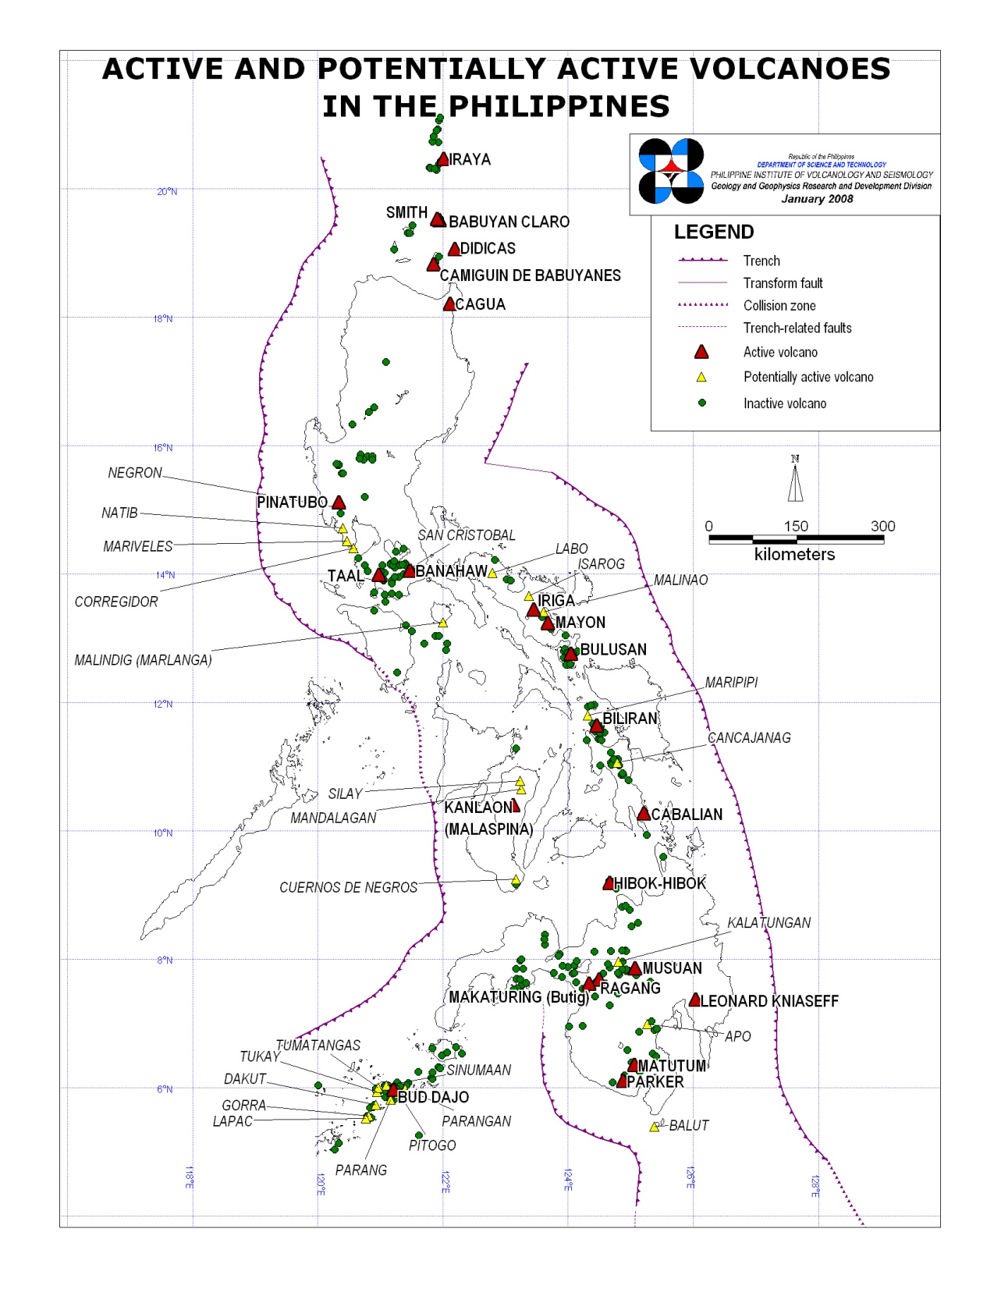
Which part of the country is the best location where a nuclear power plant can be put up?
Why do you think so?

Slide 33
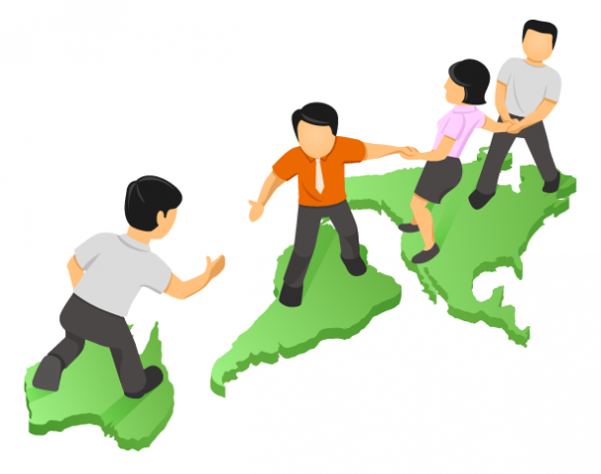
What desirable values and traits are important in order to contribute to government efforts on disaster risk reduction and awareness?

Slide 34

CAREER SPOTLIGHTING

Slide 35

Ready your QR (Quick Response) Codes for an on-the-spot survey!

Slide 36
Which career path will you choose in the future?
A. Science and Technology –Engineering –Mathematics
B. Business –Accountancy –Management
C. Humanities –Education –Social Sciences
D. Technical-Vocational

Slide 37
Product/Performance Task:
Informational Leaflet on
Disaster Preparedness
(Refer to the hand-out for instructions)

Slide 38
RUBRIC FOR THE PERFORMANCE TASK (Leaflet-making)
 | CATEGORY | 4 | 3 | 2 | 1
Presentation |  | The leaflet clearly communicates the main idea and it provokes awareness among the audience | The leaflet communicates some of the important ideas and it somehow provokes awareness among the audience | The leaflet indirectly communicates the idea, and does not provoke awareness among the audience | The leaflet does not sufficiently communicate any idea that can provoke awareness among the audience
Creativity and Originality |  | All of the graphics used on the leaflet reflect an exceptional degree of student ingenuity in their creation. | Most of the graphics used on the leaflet reflect student ingenuity in their creation. | The graphics are made by the student, but are copied from the designs or ideas of others. | No graphics made by the student are included.
Accuracy and Relevance of the Content |  | All graphics in the leaflet are accurate and related to the topic. | Most graphics in the leaflet are accurate and related to the topic. | Some graphics in the leaflet are accurate and related to the topic. | The graphics in the leaflet are neither accurate nor related to the topic.
Required Elements |  | The leaflet includes all required elements as well as additional information. | All required elements are included on the leaflet. | Few required elements are included on the leaflet. | Several required elements are missing.

Slide 39
ASSIGNMENT
Explain:
What is the basis of scientists in dividing the Earth’s lithosphere into several plates?
(Reference: Grade 10 Learners’ Material – Unit 1: Earth and Space)

