Slide 1
DEMONSTRATION TEACHING
Topic: ELECTROMAGNETIC SPECTRUM-IONIZING RADIATION
Ana Jamille A. Restubog
Teacher

Slide 2
FACT OR BLUFF
Directions:
Answer FACT if the statement given is correct and, and BLUFF if the given statement is incorrect.

Slide 3
FACT or BLUFF
1. There are different types of energy on Erath.
2. Potential energy is energy at rest while kinetic energy is energy in motion.
3. All energy forms come in the form of heat.
4. The law of conservation of energy applies to all matter on Earth.
5. Energy is the ability or capacity to do work on a system

Slide 4
Q&A
This time I will show you things you are familiar with in every day experiences and I will be asking questions about it.

Slide 5
Q&A
1. When using cellphones, why can you connect wireless to other people in different places? How do you know it is there? Do you see how this radio waves moves in the surrounding?

Slide 6
Will you give ways on how we can make it visible?

Slide 7
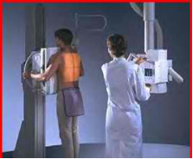
Q&A
http://www.ghyoom.net/ Can you give ways on how you could it?
1. How about, how do you know that x-rays passed through you when you have chest X-ray? Do you see the waves coming and passing through your body?

Slide 8
Can you give ways on how you see it?

Slide 9
PRE - LAB
Materials:
We will now do an activity about ionizing radiation. Kindly check the materials on your working table if they are complete. Make sure you have the following;
A.Materials needed for the Cloud Chamber:
•small transparent container with transparent lid
•flat black spray paint/black cartolina
•blotter paper
•pure ethyl alcohol
•radioactive source
•masking tape
•dry ice
•Styrofoam square
•flashlight
•gloves or tongs to handle the dry ice
B. Materials for group output
•cartolina
•permanent marker
•tape

Slide 10
ACTIVITY PROPER
Prepare three cloud chambers in accordance with the Cloud Chambers instructions:
SET UP:
a.Open the lid of the cloud chamber and saturate the felt strip inside
b.Put some alcohol on the foam in the side of the chamber
c.Then, put the radiation source inside the cloud chamber and replace the lid tightly.
d.Place the palm of your hand firmly on top of the cloud chamber for about 1 to 5 minutes to evaporate the alcohol.
e.Place the cloud chamber on a piece of FLAT dry ice that is at least a little larger than the chamber.
f.Turn off the lights in the room and point the flashlight through the cloud chamber to make the ion tracks easier to see. Tracks should begin a few minutes after placement on dry ice.

Slide 11
Guide questions
1.Because you could not see the radiation, how did you feel when as you were observing the chamber?
2.What do you think is creating the vapor tracks?
3.What do you think is happening to the radioactive source during the activity?
4.How do you think is it creating them?
5.What radiation "footprints" or patterns did you see? Describe/draw them.
6.What do you think is the importance of cloud chamber in understanding ionizing radiation?
7.What do you think happens to the source’s radioactivity after the release of radiation for some time?

Slide 12
Processing Questions for Application
1. Can you cite the important concepts learned from the discussion?
2. Having the previous knowledge about the EM spectrum, do all regions of the spectrum emit ionizing radiation? Explain why?
3. If there are EM waves that cannot produce ions, what do we call these radiation?
4. Can you cite some EM waves that are ionizing? Non –ionizing?
5. Now that you know that ionizing radiation can be traced and detected. Can you give some applications of ionizing radiation that you are familiar with? Like in medicine, industry or agriculture?

Slide 13
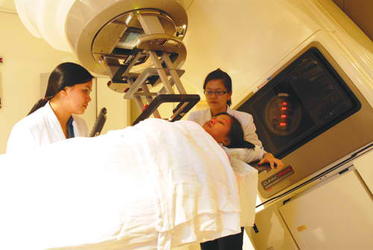
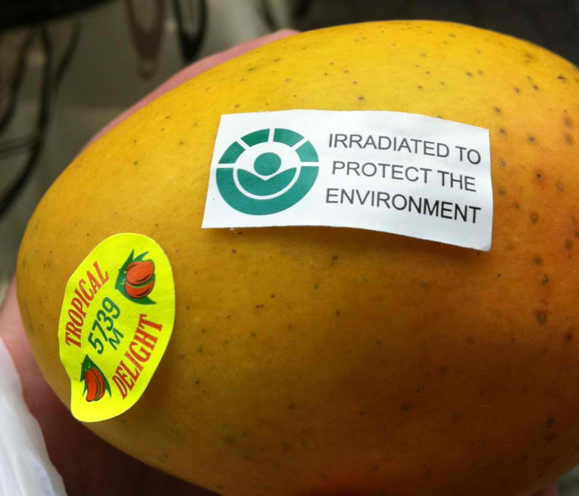
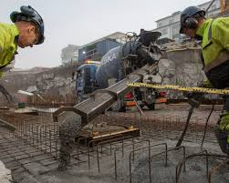
Here are some images showing the applications of ionizing radiation in our lives.
https://www.cdc.gov/nceh/radiation/ionizing.htm
http://www.parkwaycancercentre.com/
http://www.lkabminerals.com/en/industry-uses/building--construction/

Slide 14
GENERALIZATION
Through your own graphic organizer/ concept map summarize the important things you learned in today’s lesson

Slide 15
TRUE, FALSE OR UNDECIDED?
in this activity you will be given statements related to the lesson. you will answer either true, false or undecided for each statement. You will line up in front of your answer which is posted on the board.

Slide 16
TRUE, FALSE OR UNDECIDED?
1. Visible light and radio waves are examples of ionizing radiation.
2. Ionizing radiation is emitted in a straight single path from a source towards the environment
3. Ionizing radiation can cause harmful effects if not handled properly
4. Ionizing radiation is mainly used for telecommunication technology
5. Ionizing radiation has the ability to create ions as it interacts with its environment.

Slide 17
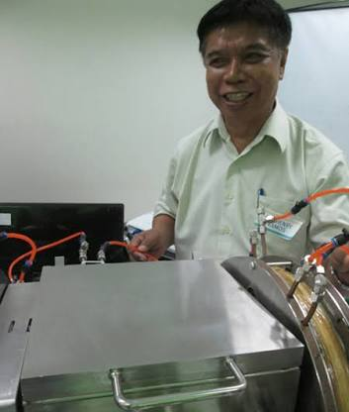
Career Spotlight
Inventor/ Researcher
Young Scientist

Slide 18
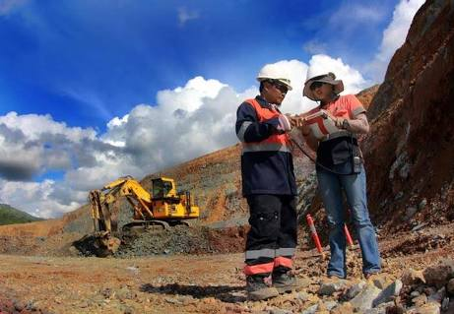
Career Spotlight
Health Officer
Engineer

Slide 19
Teacher

Slide 20
ASSIGNMENT
Kindly take note of the following for your homework activities.
1.What are the other detectors used for ionizing radiation aside from cloud chamber?
2.Search some hospitals or other institutions near your place where ionizing radiation applications are used. List the technology and how the workers handle it.
References: www.physicsclassroom.com, Physics by Giancoli and other physics books, visit also PNRI website.

Slide 21
THANK YOU!

